Slide 1

Comparison of RNN, LSTM, and GRU on MNIST

Slide 2

Reference
Chapter 14 (O'Reilly) of Hands-On ML
Youtube on MNIST
Youtube on CNN on MNIST
Youtube on RNN on MNIST
Youtube on LSTM on MNIST
Youtube on GRU on MNIST
Youtube

Slide 3
Data

Slide 4
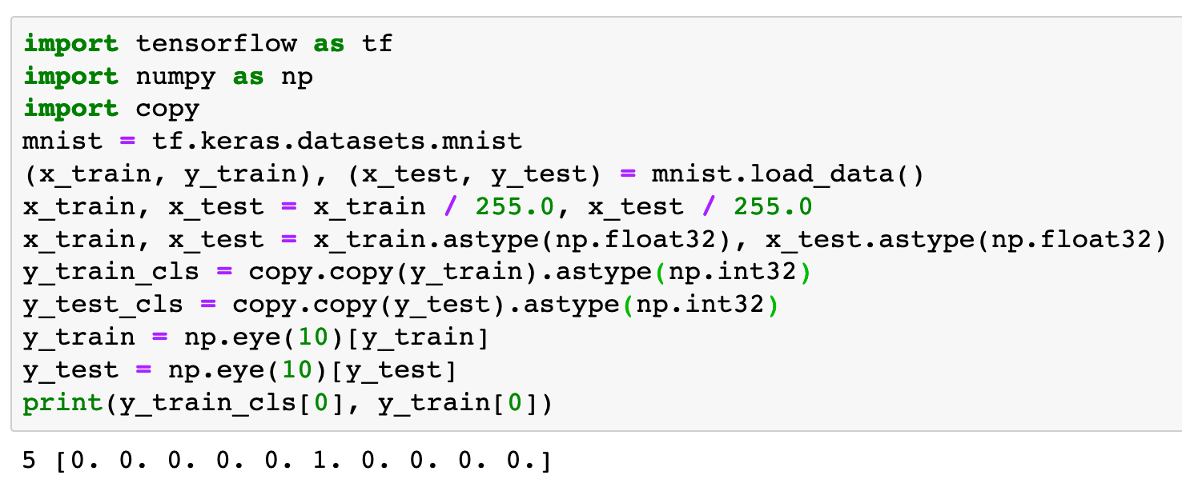

Slide 5
Warm Up

Slide 6
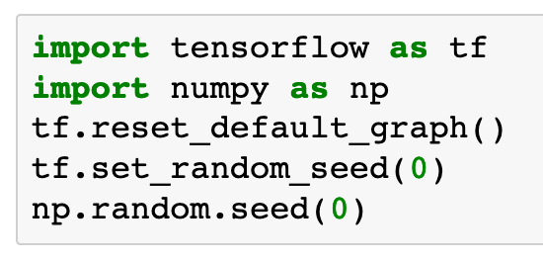

Slide 7
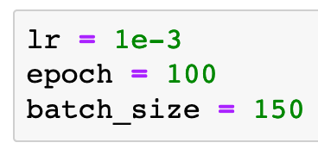

Slide 8
Graph

Slide 9
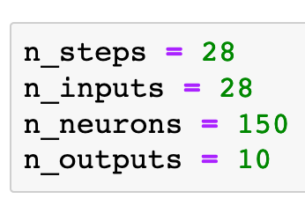

Slide 10
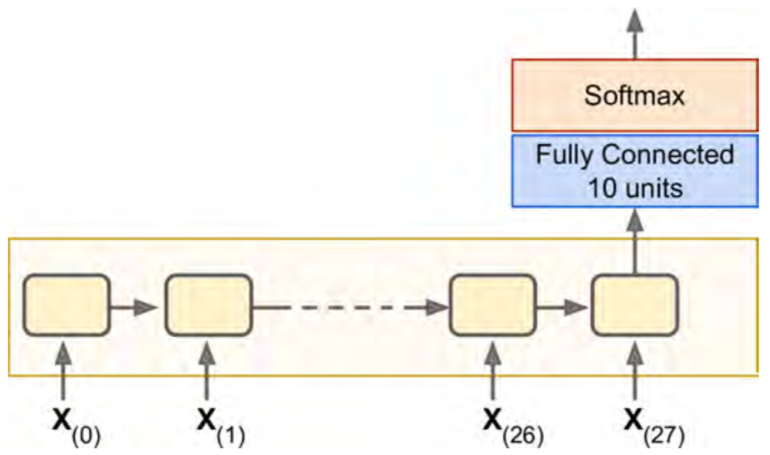
Chapter 14 (O'Reilly) of Hands-On ML

Slide 11


Chapter 14 (O'Reilly) of Hands-On ML

Slide 12

Chapter 14 (O'Reilly) of Hands-On ML

Slide 13
Chapter 14 (O'Reilly) of Hands-On ML

Slide 14
Chapter 14 (O'Reilly) of Hands-On ML

Slide 15

Chapter 14 (O'Reilly) of Hands-On ML

Slide 16
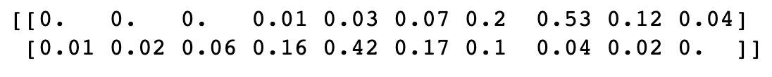
Chapter 14 (O'Reilly) of Hands-On ML

Slide 17
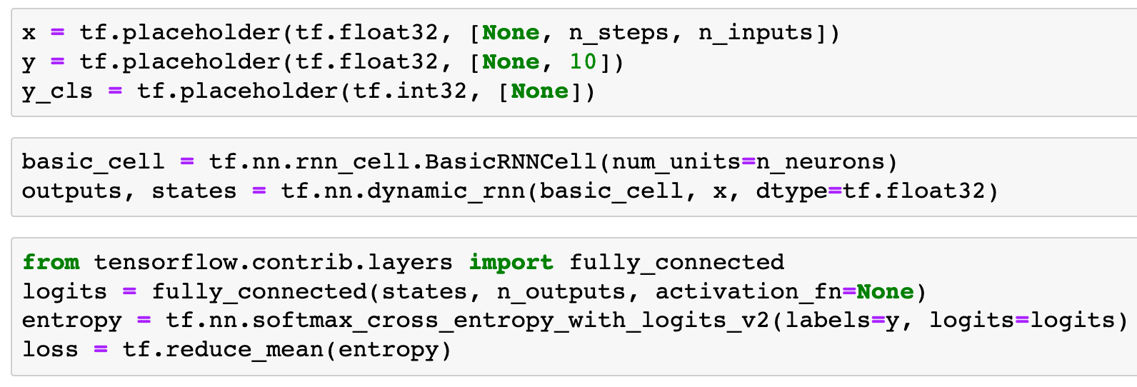
RNN on MNIST

Slide 18
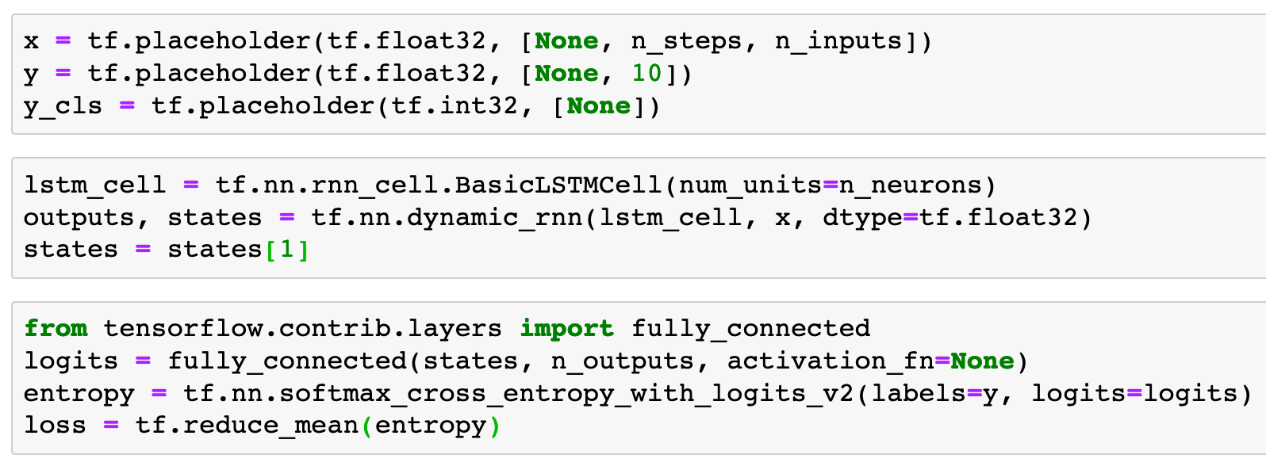
LSTM on MNIST

Slide 19
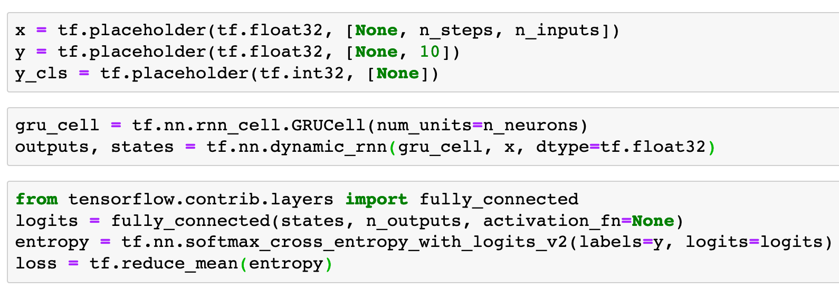
GRU on MNIST

Slide 20
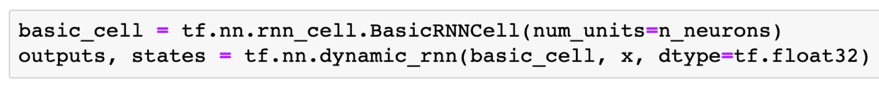

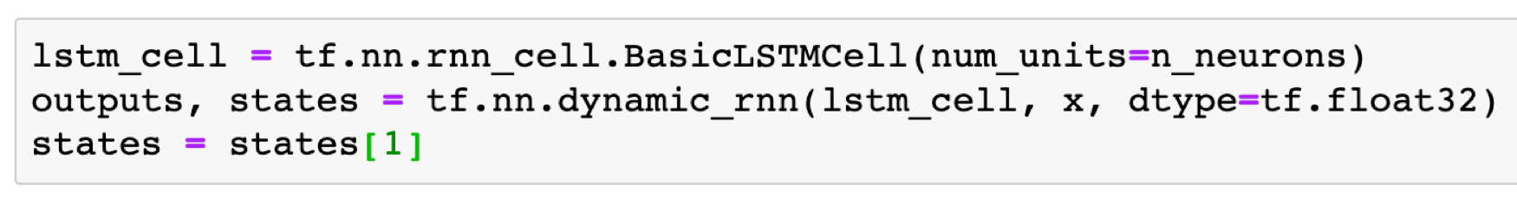
RNN on MNIST
Previously in LSTM on MNIST
Now

Slide 21
RNN on MNIST
LSTM on MNIST
Now

Slide 22
RNN on MNIST
LSTM on MNIST
GRU on MNIST

Slide 23
RNN on MNIST
LSTM on MNIST
GRU on MNIST

Slide 24
RNN on MNIST
LSTM on MNIST
GRU on MNIST

Slide 25
RNN on MNIST
LSTM on MNIST
GRU on MNIST

Slide 26
RNN on MNIST
LSTM on MNIST
Note
GRU on MNIST

Slide 27
RNN on MNIST
LSTM on MNIST
Note
GRU on MNIST

Slide 28
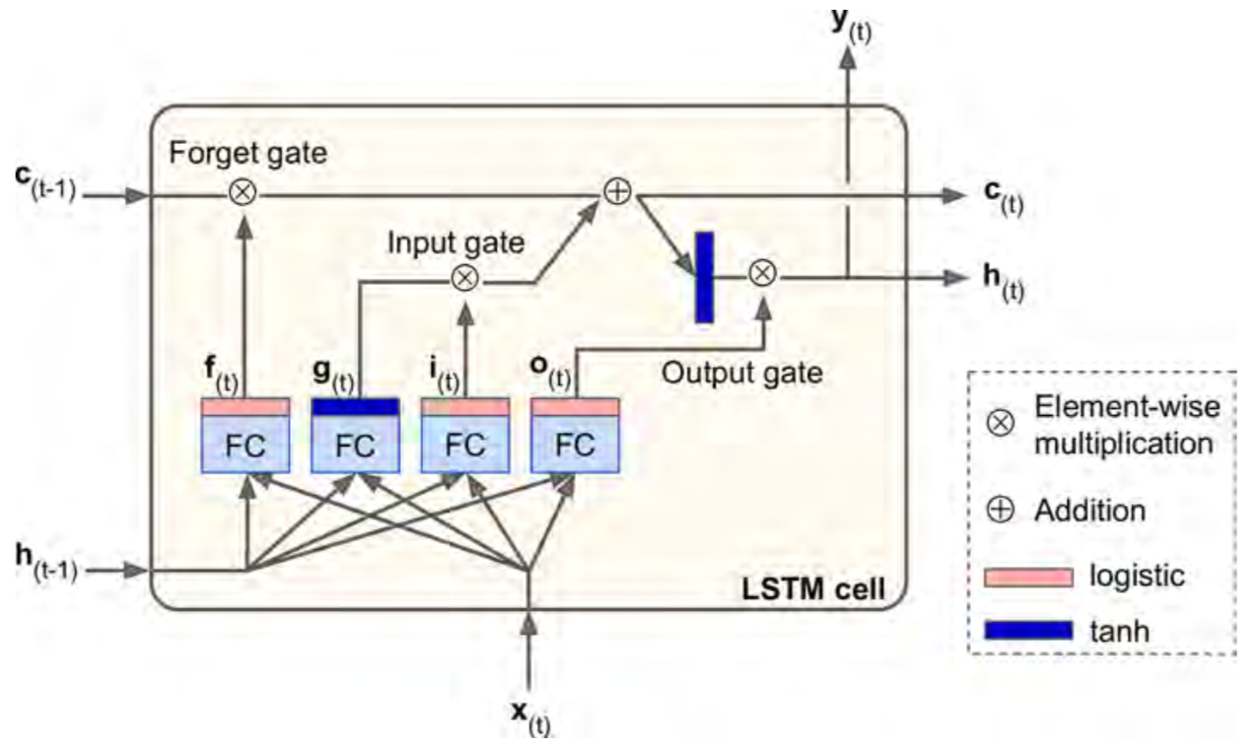
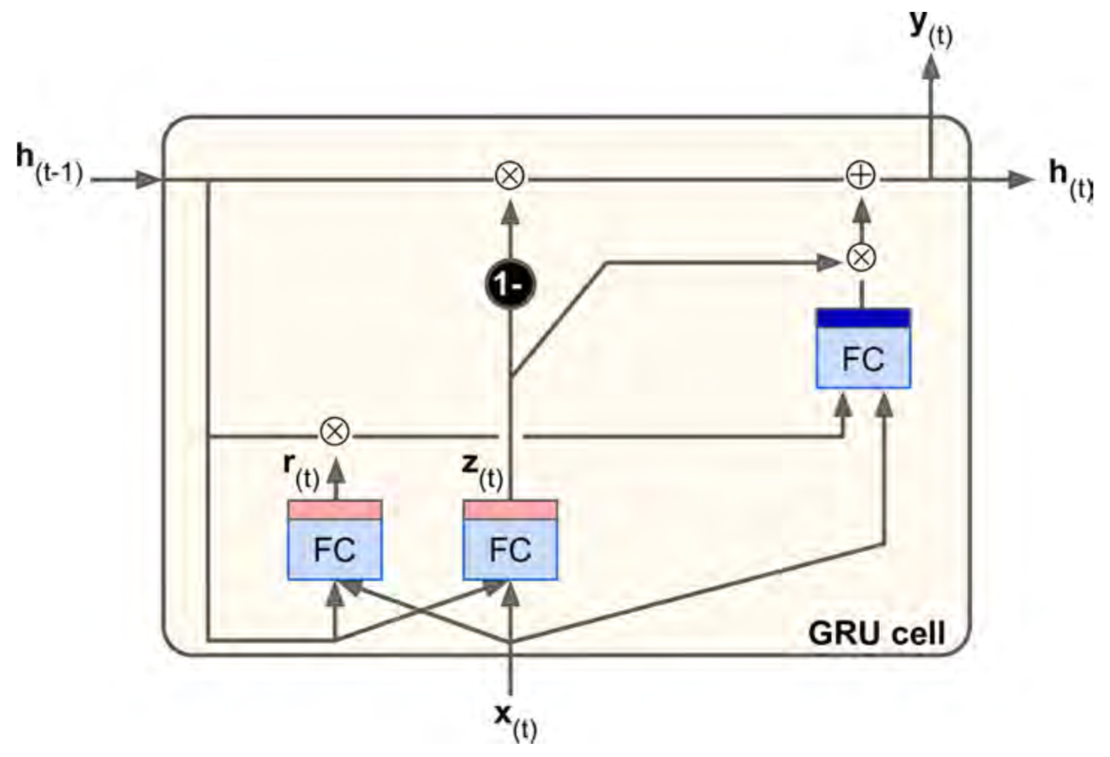
Chapter 14 (O'Reilly) of Hands-On ML
Chapter 14 (O'Reilly) of Hands-On ML
LSTM cell
GRU cell

Slide 29
Chapter 14 (O'Reilly) of Hands-On ML
Chapter 14 (O'Reilly) of Hands-On ML
LSTM cell
GRU cell

Slide 30
Chapter 14 (O'Reilly) of Hands-On ML

Slide 31
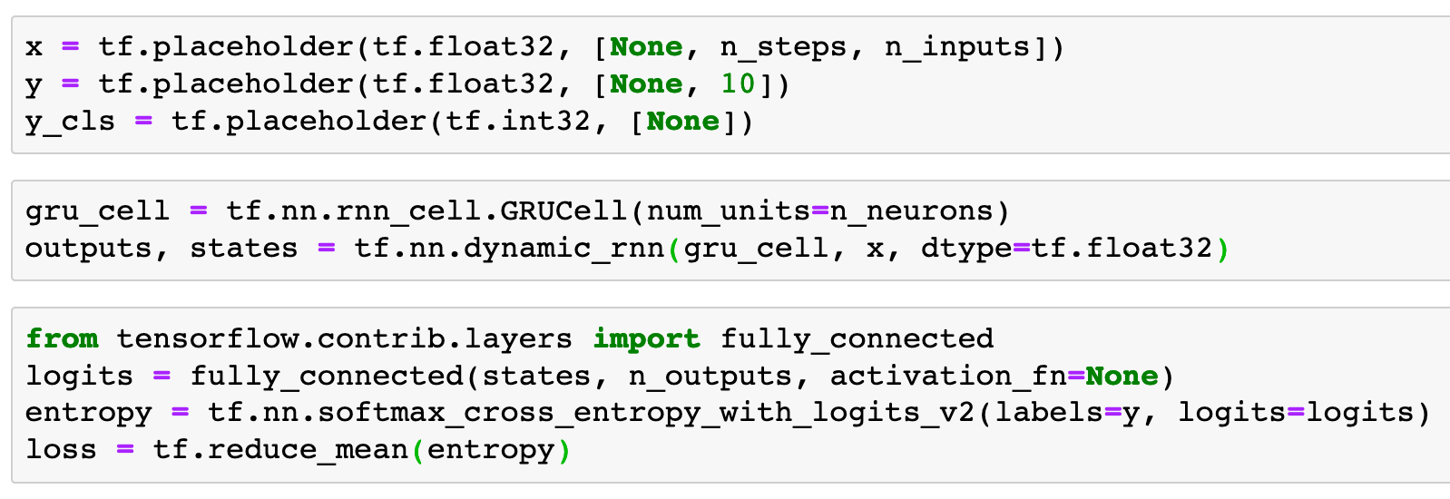

Chapter 14 (O'Reilly) of Hands-On ML

Slide 32
Chapter 14 (O'Reilly) of Hands-On ML
x

Slide 33
Chapter 14 (O'Reilly) of Hands-On ML
(?,28,28)
x

Slide 34
Chapter 14 (O'Reilly) of Hands-On ML
(?,28,28)
x

Slide 35
Chapter 14 (O'Reilly) of Hands-On ML
states
(?,28,28)
x

Slide 36
Chapter 14 (O'Reilly) of Hands-On ML
states
(?,150)
(?,28,28)
x

Slide 37
Chapter 14 (O'Reilly) of Hands-On ML
states
(?,150)
(?,28,28)
x

Slide 38
Chapter 14 (O'Reilly) of Hands-On ML
logits
states
(?,150)
x

Slide 39
Chapter 14 (O'Reilly) of Hands-On ML
(?,10)
logits
states
(?,150)
x

Slide 40
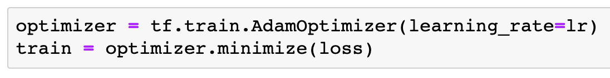

Slide 41
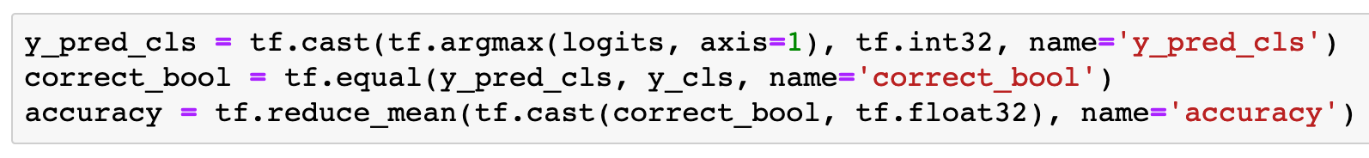

Slide 42
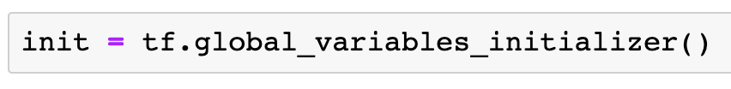

Slide 43
Session

Slide 44
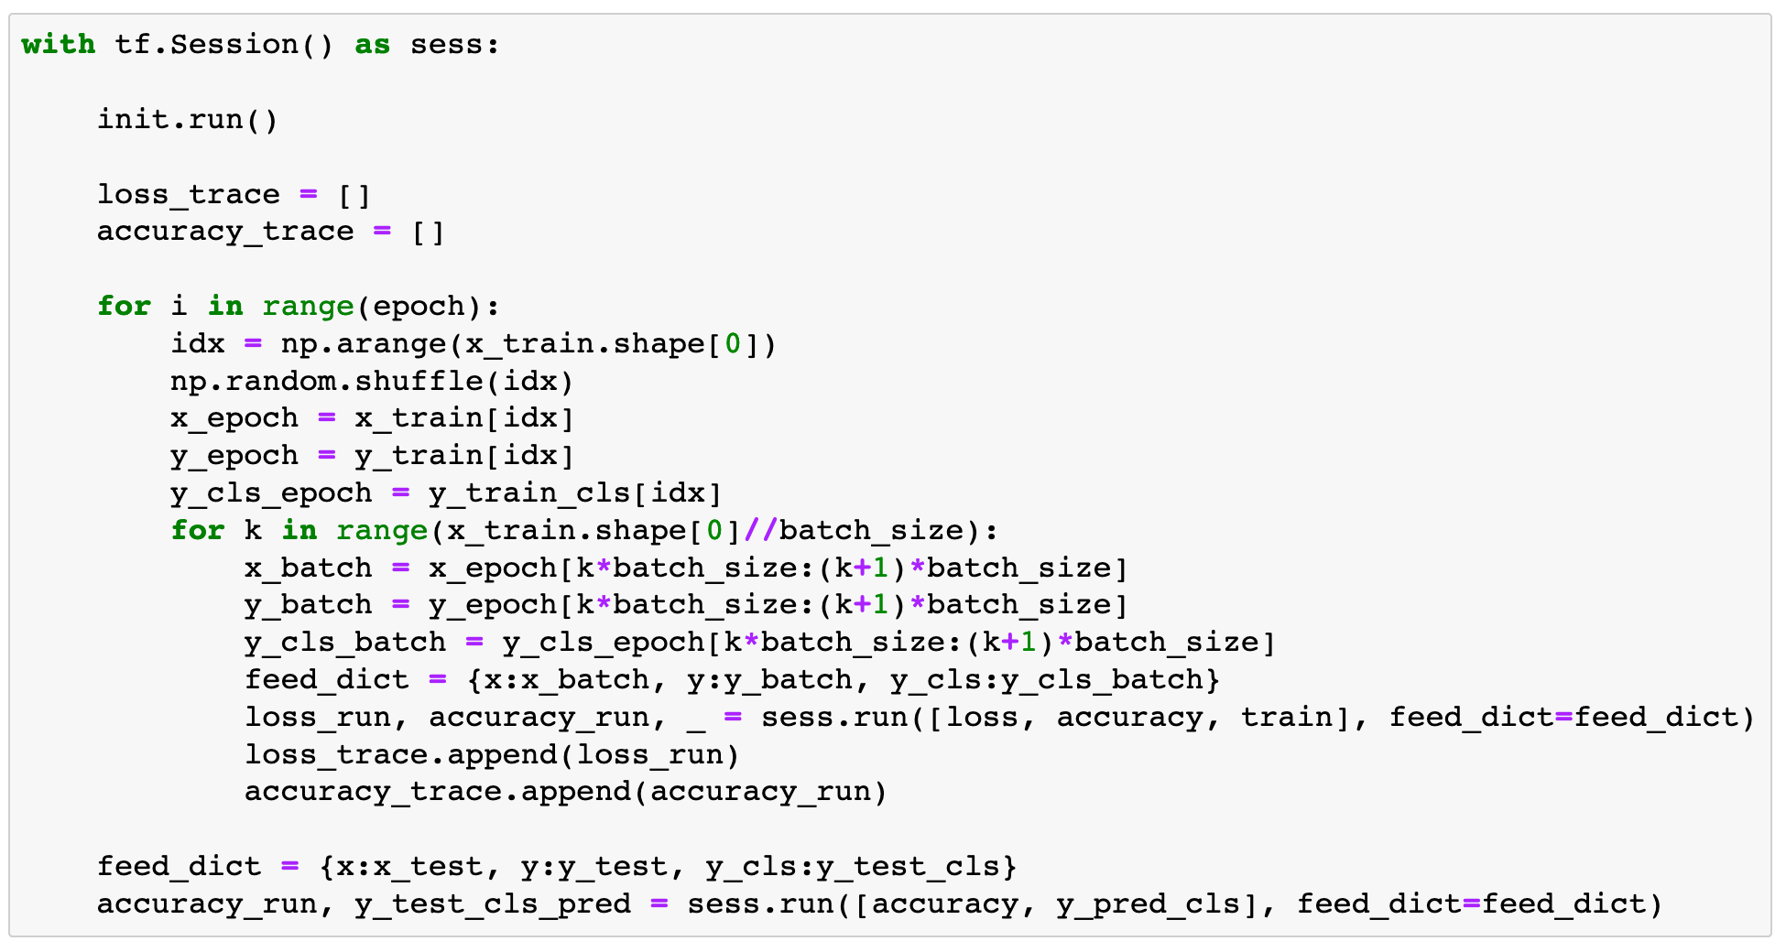

Slide 45
Report Result

Slide 46
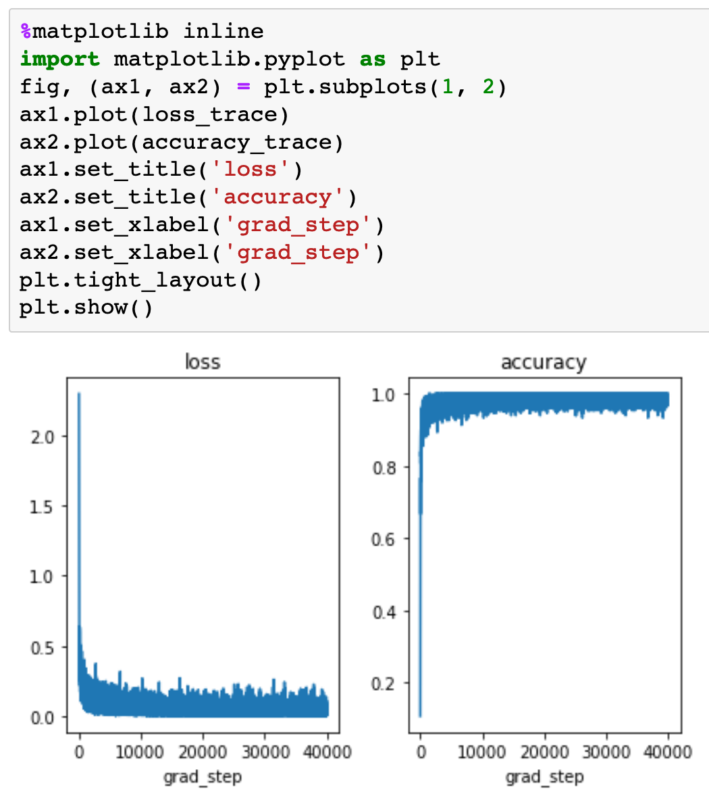

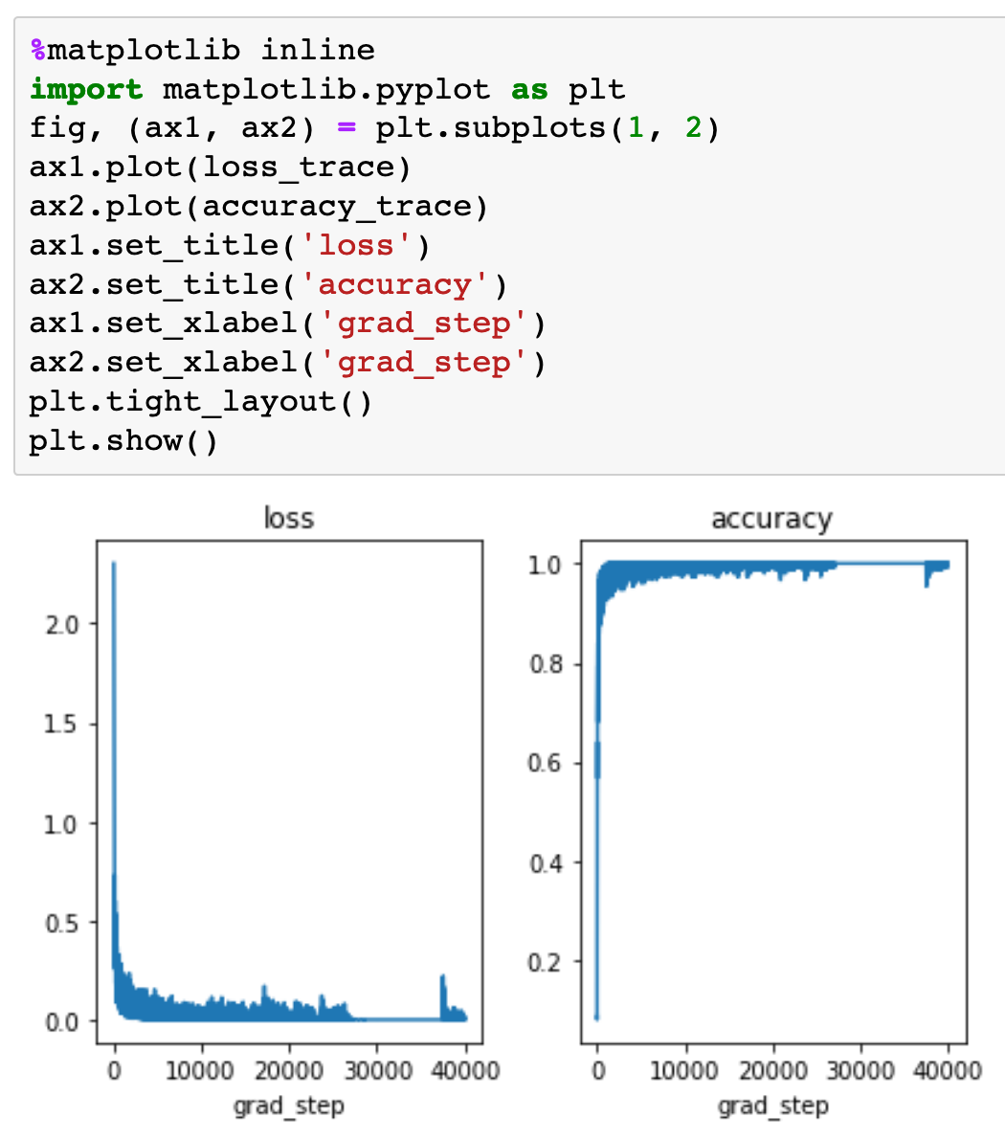
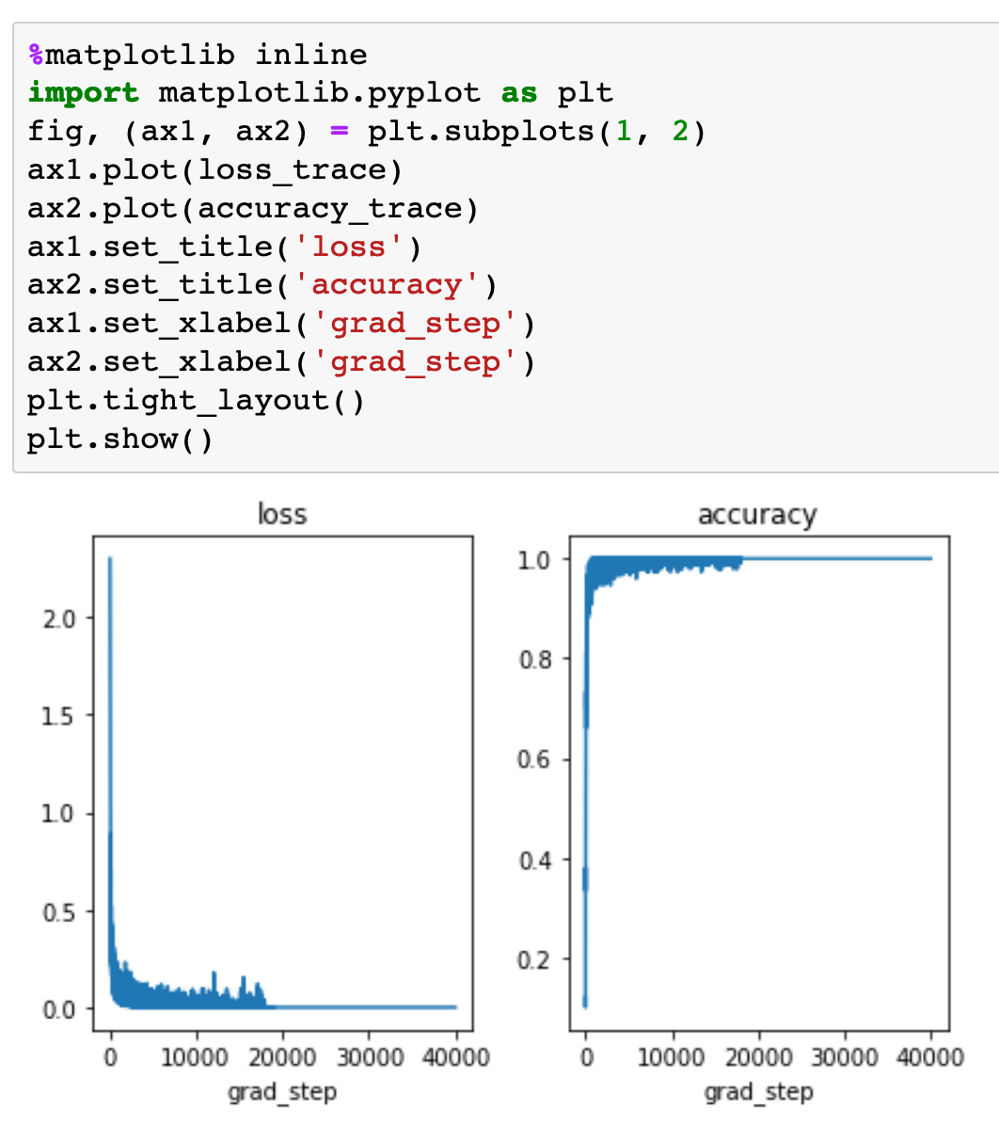
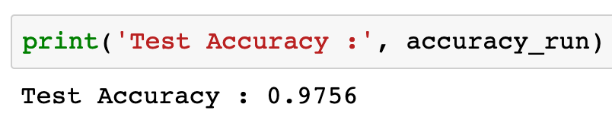
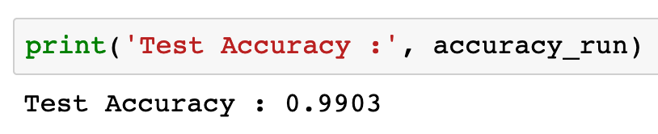
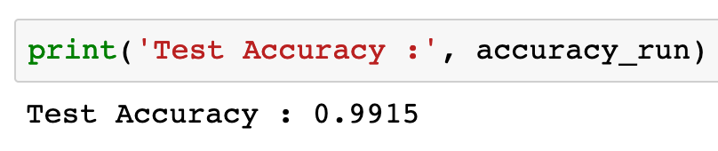
RNN
LSTM
GRU

Slide 47
RNN
LSTM
GRU

Slide 48
RNN
LSTM
GRU

Slide 49
RNN
LSTM
GRU

Slide 50
RNN
LSTM
GRU

Slide 51
RNN
LSTM
GRU

Slide 52
RNN
LSTM
GRU

Slide 53
Now
Let’s Play with Code

